Slide 1
Preparing Aquarium Fish for Auction
Our Annual Auction is April 22nd
Here at the Churchville Nature Center

Slide 2
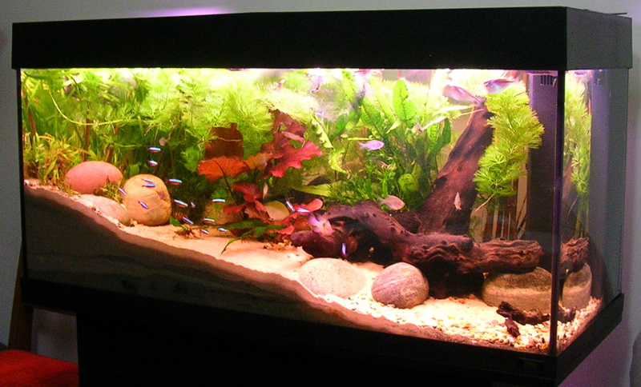
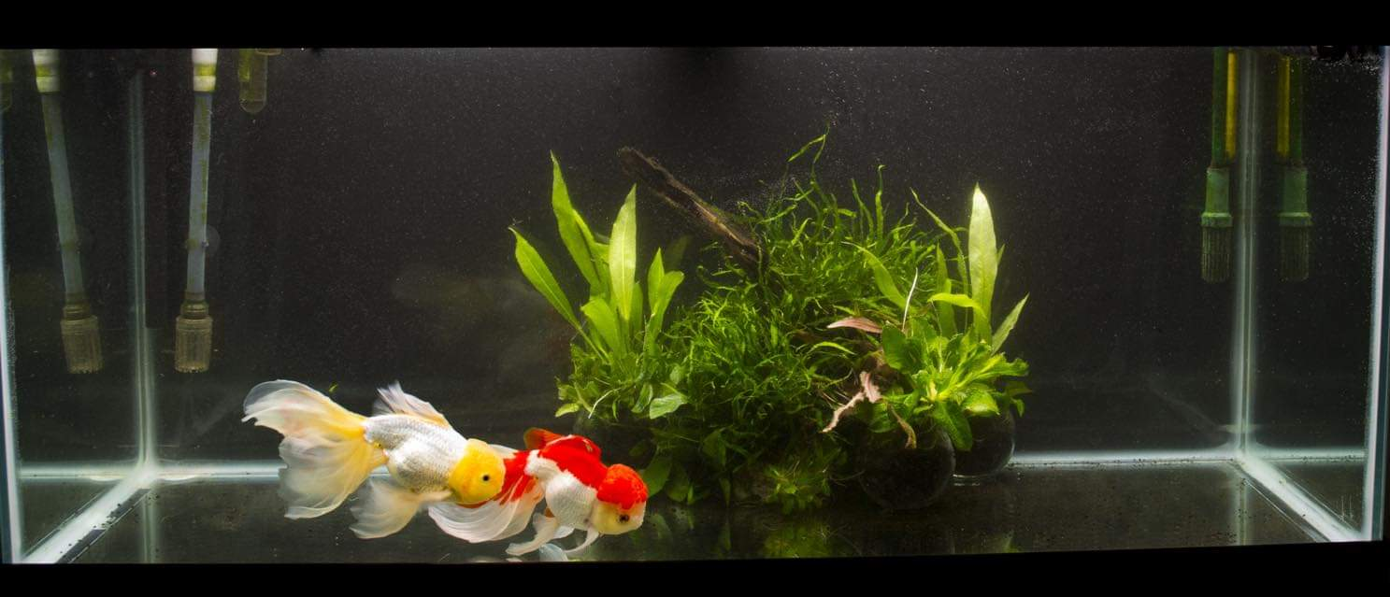
Move your for-sale fish to Quarantine tanks
Aim for at least a few days ahead of auction, ideally a week
Easier to catch later
Easier to observe for disease
You are going to want those quarantine tanks up and running anyway for whatever you buy at auction

Slide 3
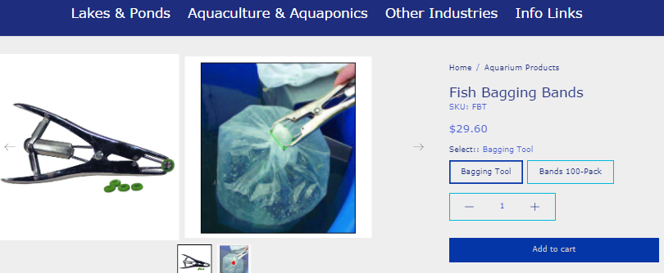
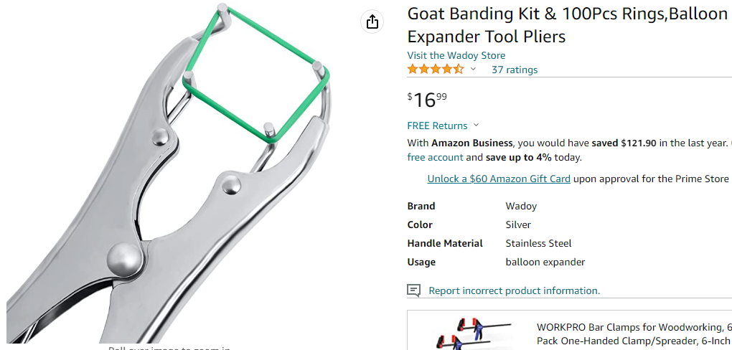
Gather supplies ahead of time
Plastic Bags
2 mil gauge, good for short distance transfers or for bagging aquatic plants.
3 mil gauge, best for shipping fish or long term holding.
4 mil gauge bags for more aggressive species or longer term secure bagging.
Available from https://www.jehmco.com/html/plastic_bags.html
Breather bags are a bad idea at large auctions
Rubber bands
Just regular ones, JUST MAKE SURE THEY ARE NOT TOO THIN
Or get fancy and get a balloon expander tool (but don’t overpay, they are like $10 at tractor supply)

Slide 4
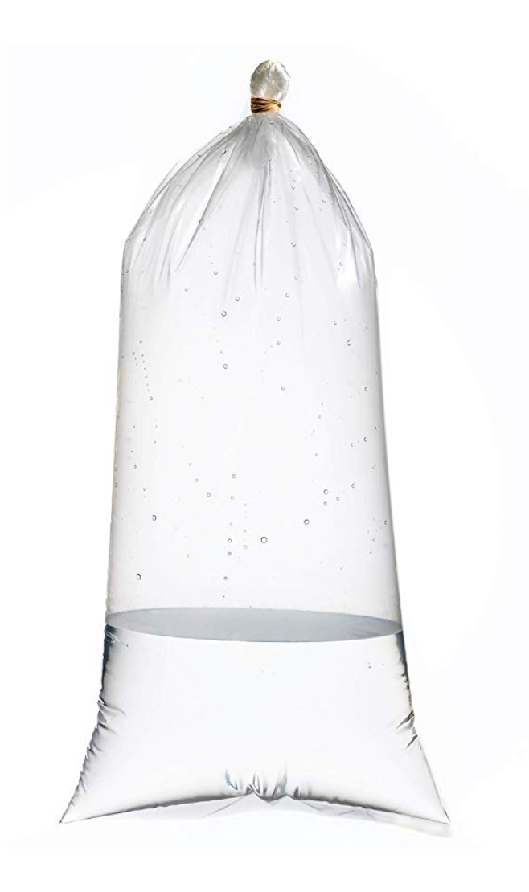
Bag sizing
How Big is your fish?
Torpedo shaped fish, measure nose to tail
Round shaped fish, measure top to bottom
Bag should be at least 4 times as tall as that measurement, to make sure there will be enough water to cover the fish and allow them to move
Width of bag should be at least twice the width (nose to tail) of the fish for individual fish. Treat fish under 1” as 1”
Allow more room for groups of fish (one more fish width for every 2 individuals added)
Bigger bag is always better
Single fish in bag is also technically always better

Slide 5
NO ziplock baGs

Slide 6
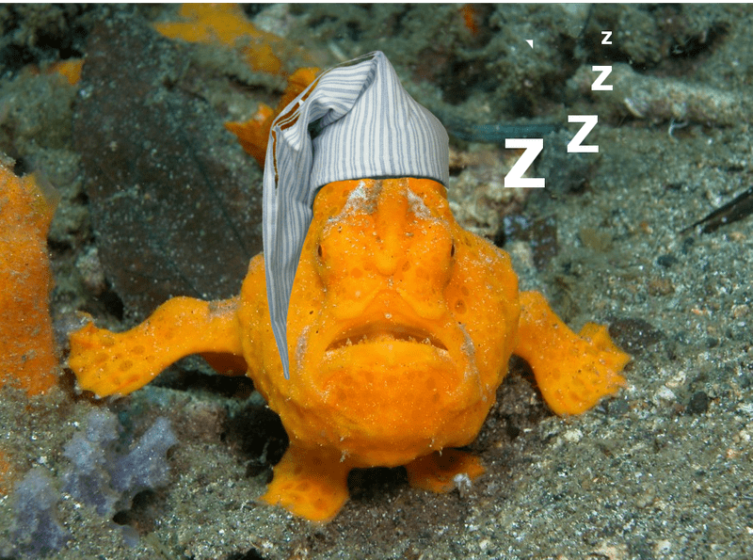
24-48 Hours before the auction
Stop Feeding the fish
Over this time, lower the temperature to about 10 degrees lower than it normally is for this fish

Slide 7
Fish catching tips
Leave yourself time, fish seem to have an innate sense of when you are rushing.
Pull out any decorations that might get caught on the net
Turn off the lights on the tank, catch em while they are sleeping
Lower the water level to help box them in
Consider catching more delicate or spined fishes in a specimen container instead of a net
Take your time, don’t stress them out

Slide 8
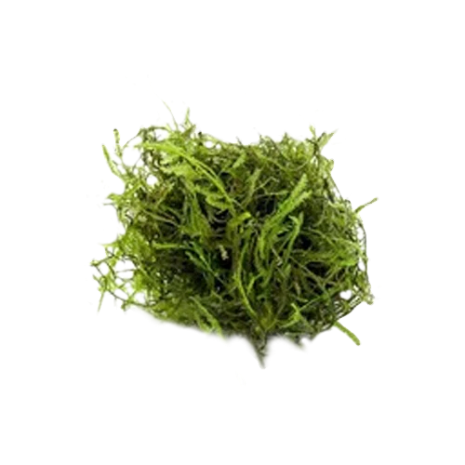
Bagging the Fish
Fill the bag ¼ to 1/3 full of water
Use either tank water or temp matched new water with similar parameters
Adding a small sprig of java moss or similar plant may help the fish to feel more secure in the bag
Adding a dose of ammonia remover or slime coat additive can help protect the fish during its time in the bag
Adding a small piece of poly-filter will additionally protect the fish, as long as it is too big for the fish to try and eat
Separate males from females, for pairs or groups of fish that might be aggressive, you can always bag the bags together or tape them together for the lot
Don’t blow air into the bag yourself
Secure the top of the bag with rubber bands. Fold the flap over on the top of the bag, then keep wrapping and twisting a rubber band over the folded flap as many times as you can. Add a second or third rubber band for added security.

Slide 9
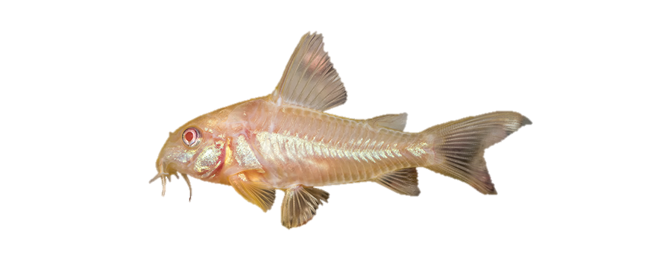
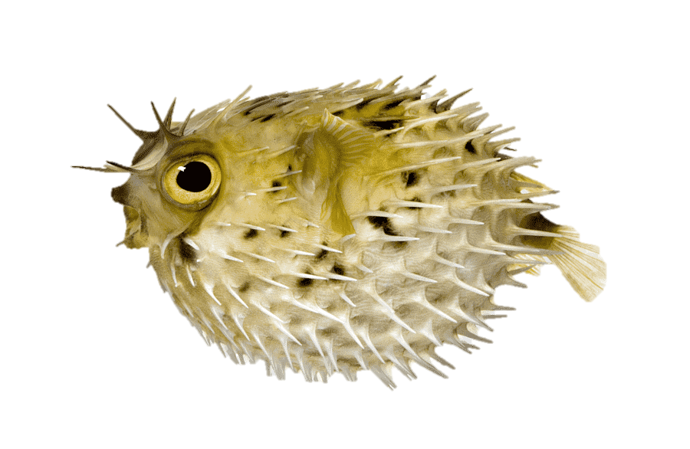
Double bagging
Highly recommended in general
Crucial for our spined fishes
If you put the first bag upside-down into the second bag, it creates a rounded shape and prevents fish from getting caught in the bag corners

Slide 10
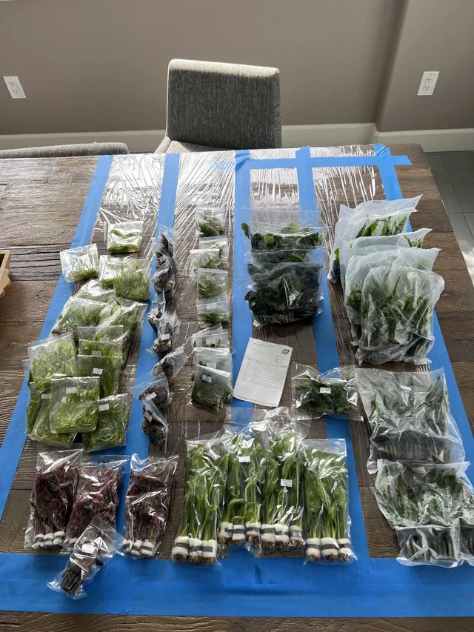
Plants
Do not need double bagging
Do not need as much water or air for that matter, add enough to keep the roots wet, don’t feel the need to fill the bag out
Please still do not use ziplock bags

Slide 11
Label
Can be printed from MYGROUPAUCTIONS
Make sure lot number is clearly visible
Contact info
A photo of the fish (or parents) can be useful on the label
the more information you can provide to the auctioneers, the more easily they can sell your fish to a suitable home, and for the best possible price
Put tape over your label

Slide 12
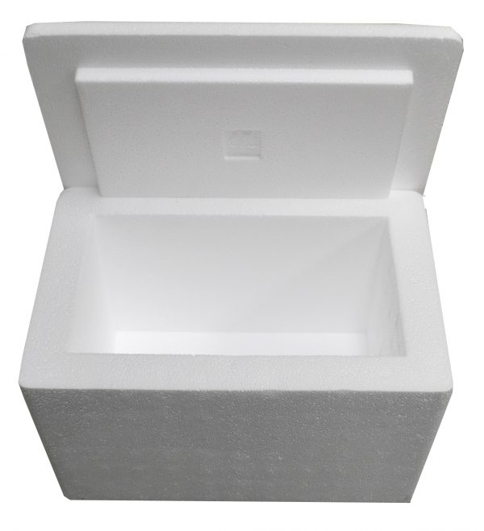
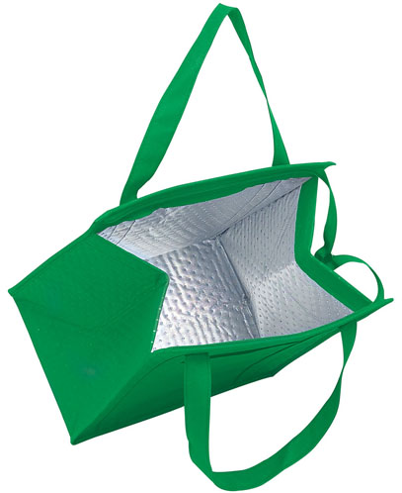
Transport
Keep fish insulated
Good ole’ styro
Insulated lunch bags
Coolers
Keep fish in the dark until ready to put on the auction table
Try not to shake or spin the bags
Consider heat packs or ice packs at temperature extremes (wrap them)

Slide 13
See you at the Auction!!!
We have many donations from our sponsors that will go through the auction
We will have raffles and a plant sale additionally
There will be food available for purchase during the auction
Preregistrants (enter lots earlier than day-of) will get priority stickers to cover 1/3 of their items
After all priority items are sold, we will allow pushing of items for $2
Lot limit is 35 lots
No used heaters or used substrates are allowed in the auction.
Abandoned lots will become bcas property
Every bidder will have a bidder card and run a tab, there will be no pay-as-you-go option. You must pay for your lots before you leave
Payment to sellers will be made by BCAS check. The payments will be sent within 3 weeks of the auction date.

